Slide 1
FedEx Logistics Optimization Using SQL Analytics
Shipment Delay Analysis • Route Optimization • Warehouse Performance
Saumya Jaiswal from 01 September batch

Slide 2
Objectives of the Project
Build a SQL-driven logistics analytics system to analyze shipment performance, optimize routes, and enhance delivery efficiency across FedEx’s global network. The project aims to:
● Identify delay patterns and operational inefficiencies.
● Optimize hub and route combinations for improved transit times.
● Analyze agent- and warehouse-level performance.

Slide 3
Dataset Overview
1. Orders Table
The Orders dataset contains order-level delivery details including order date, route, warehouse, and payment type. Order_ID, Customer_ID, Order_Date, Route_ID, Warehouse_ID, Order_Amount, Delivery_Type, Payment_Mode
2. Routes Table
The Routes dataset includes route-level transportation details, covering the source and destination cities, countries, total distance, and average transit time (in hours). Route_ID, Source_City, Source_Country, Destination_City, Destination_Country, Distance_KM, Avg_Transit_Time_Hours
3. Warehouses Table
The Warehouses dataset provides location-level information about FedEx’s major hubs and sortation centers. Warehouse_ID, City, Country, Capacity_per_day, Manager_Name
4. Delivery Agents Table
The Delivery Agents dataset contains agent-level performance data, including agent ID, name, assigned zone and country, experience, and customer rating. Agent_ID, Agent_Name, Zone, Zone_Country, Experience_Years, Avg_Rating
5. Shipment Tracking Table
The Shipments dataset includes shipment-level tracking information with timestamps for pickup and delivery, delay duration, and feedback ratings. It captures operational data that helps analyze transit time, on-time delivery percentage, and service-level adherence across routes and agents. Shipment_ID, Order_ID, Agent_ID, Route_ID, Warehouse_ID, Pickup_Date, Delivery_Date, Delivery_Status, Delay_Hours, Delivery_Feedback

Slide 4
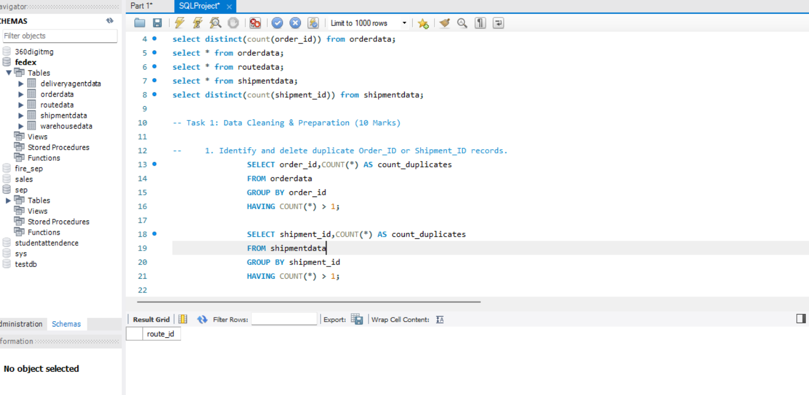
Task 1 : Data Cleaning & Preparation 1. Identify and delete duplicate Order_ID or Shipment_ID records.
MySQL Query-
SELECT order_id,COUNT(*) AS count_duplicates FROM orderdataGROUP BY order_id HAVING COUNT(*) > 1;
SELECT shipment_id,COUNT(*) AS count_duplicates FROM shipmentdata GROUP BY shipment_id HAVING COUNT(*) > 1;

Slide 5
Task 1 : Data Cleaning & Preparation 2. Replace null or missing Delay_Hours values in the Shipments Table with the average delay for that Route_ID.
MySQL Command
SELECT * FROM shipmentdata; SELECT route_id FROM shipmentdata WHERE delay_hours IS NULL;
/* so there is no null or missing values for route_id*/

Slide 6
Task 1 : Data Cleaning & Preparation 3. Convert all date columns (Order_Date, Pickup_Date, Delivery_Date) into YYYY-MM-DD HH:MM:SS format using SQL date functions.
SELECT * FROM orderdata;
describe orderdata;
alter table orderdata modify order_date timestamp;
describe orderdata;
SELECT * FROM shipmentdata;
DESCRIBE shipmentdata;
ALTER TABLE shipmentdata MODIFY pickup_date TIMESTAMP; DESCRIBE shipmentdata;
SELECT * FROM shipmentdata;
DESCRIBE shipmentdata;
ALTER TABLE shipmentdata MODIFY delivery_date TIMESTAMP; DESCRIBE shipmentdata;

Slide 7
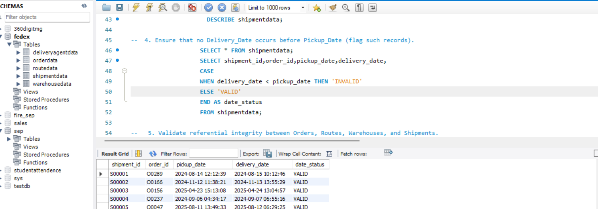
Task 1 : Data Cleaning & Preparation 4. Ensure that no Delivery_Date occurs before Pickup_Date (flag such records).
SELECT * FROM shipmentdata;
SELECT shipment_id,order_id,pickup_date,delivery_date, CASE
WHEN delivery_date < pickup_date THEN 'INVALID’ ELSE 'VALID’ END AS date_status FROM shipmentdata;

Slide 8
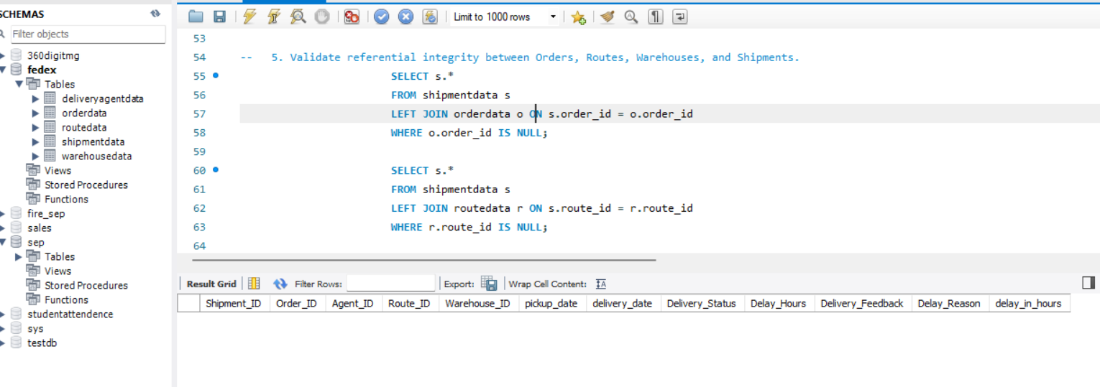
Task 1 : Data Cleaning & Preparation 5. Validate referential integrity between Orders, Routes, Warehouses, and Shipments.
SELECT s.* FROM shipmentdata s LEFT JOIN orderdata o ON s.order_id = o.order_id WHERE o.order_id IS NULL;
SELECT s.* FROM shipmentdata s LEFT JOIN routedata r ON s.route_id = r.route_id WHERE r.route_id IS NULL;
SELECT s.* FROM shipmentdata s LEFT JOIN warehousedata w ON s.warehouse_id = w.warehouse_id WHERE w.warehouse_id IS NULL;

Slide 9
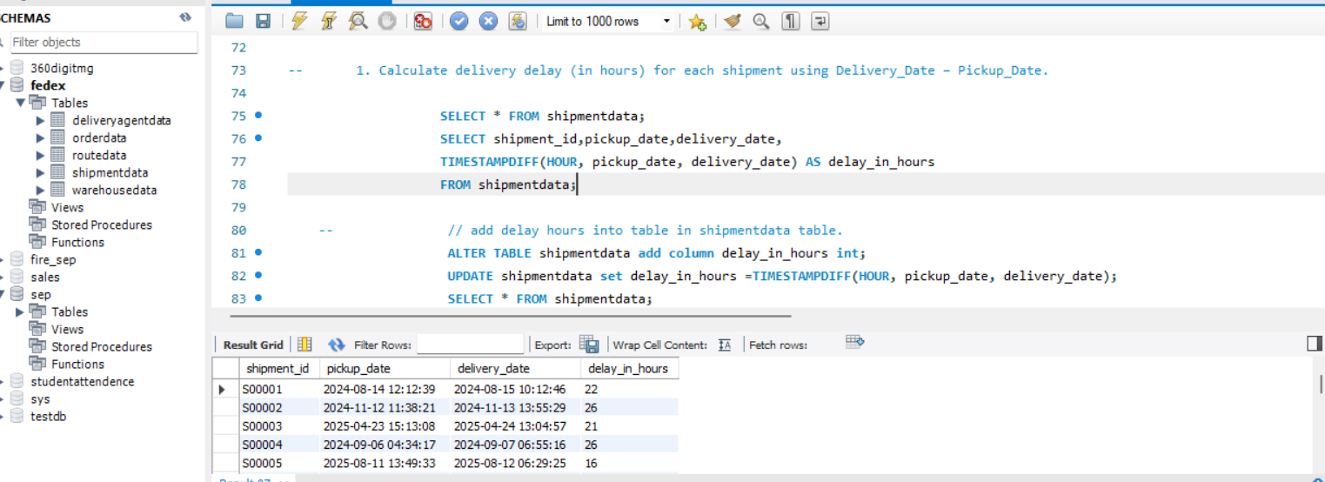
Task 2: Delivery Delay Analysis (10 Marks)-- 1. Calculate delivery delay (in hours) for each shipment using Delivery_Date – Pickup_Date.
SELECT * FROM shipmentdata;
SELECT shipment_id,pickup_date,delivery_date,
TIMESTAMPDIFF(HOUR, pickup_date, delivery_date) AS delay_in_hours FROM shipmentdata;
// add delay hours into table in shipmentdata table.
ALTER TABLE shipmentdata add column delay_in_hours int;
UPDATE shipmentdata set delay_in_hours =TIMESTAMPDIFF(HOUR, pickup_date, delivery_date);
SELECT * FROM shipmentdata;

Slide 10
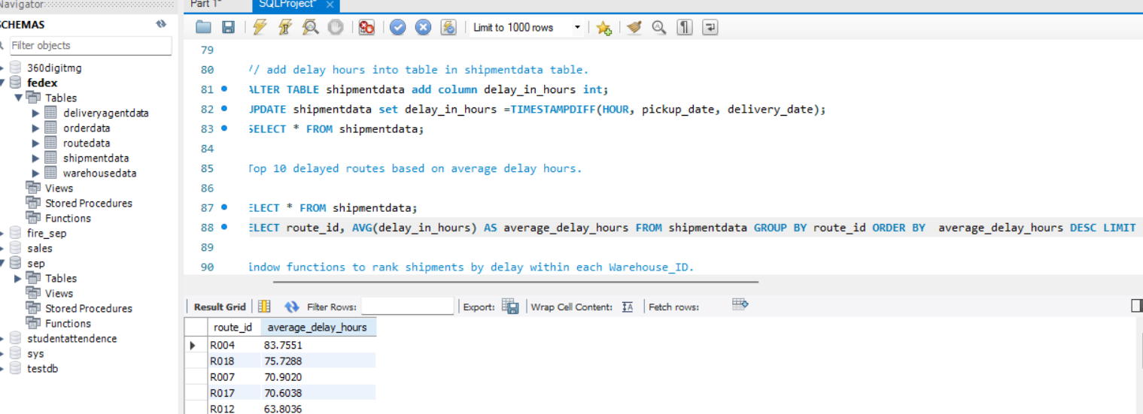
Task 2: Delivery Delay Analysis (10 Marks)-- 2. Find the Top 10 delayed routes based on average delay hours.
SELECT * FROM shipmentdata;
SELECT route_id, AVG(delay_in_hours) AS average_delay_hours FROM shipmentdata GROUP BY route_id ORDER BY average_delay_hours DESC LIMIT 10;

Slide 11
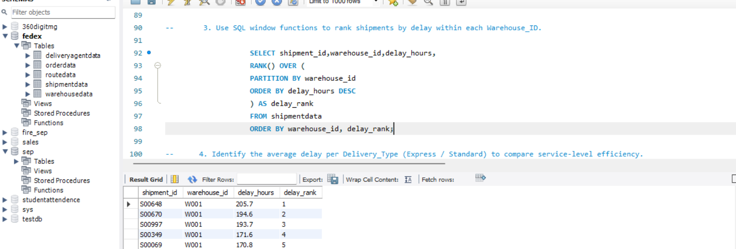
Task 2: Delivery Delay Analysis (10 Marks)-- 3. Use SQL window functions to rank shipments by delay within each Warehouse_ID.
SELECT shipment_id,warehouse_id,delay_hours,
RANK() OVER ( PARTITION BY warehouse_id ORDER BY delay_hours DESC ) AS delay_rank FROM shipmentdata ORDER BY warehouse_id, delay_rank;

Slide 12
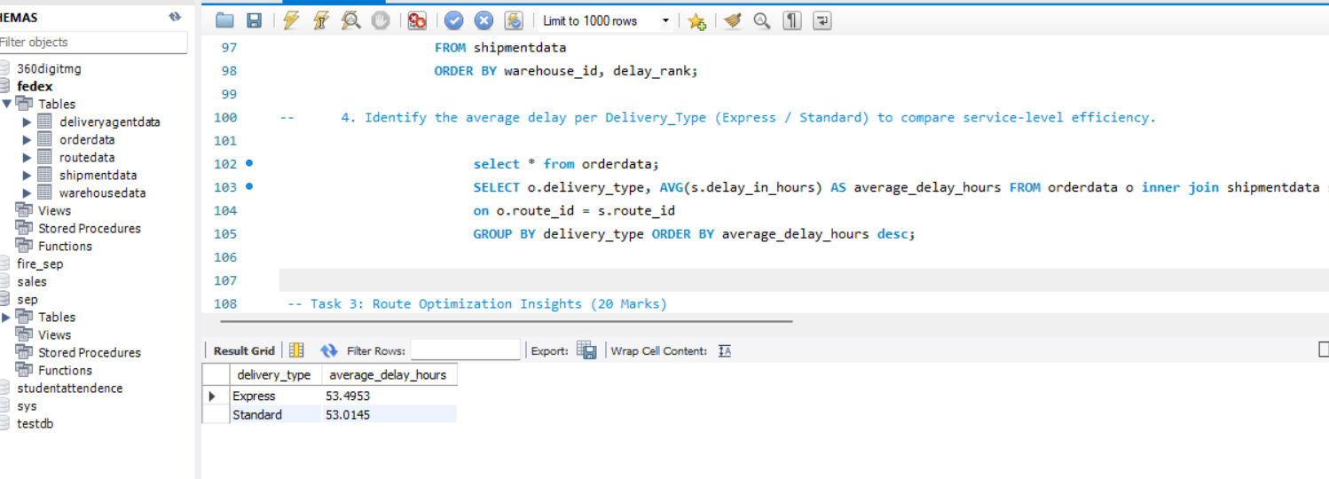
Task 2: Delivery Delay Analysis (10 Marks)-- 4. Identify the average delay per Delivery_Type (Express / Standard) to compare service-level efficiency.
select * from orderdata;
SELECT o.delivery_type, AVG(s.delay_in_hours) AS average_delay_hours FROM orderdata o inner join shipmentdata s on o.route_id = s.route_id GROUP BY delivery_type ORDER BY average_delay_hours desc;

Slide 13
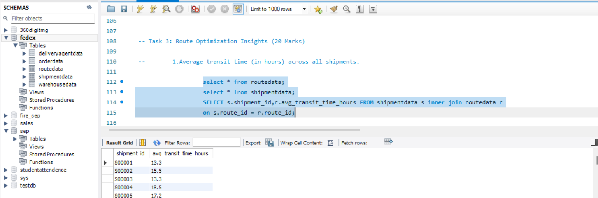
Task3:Route Optimization Insights (20 Marks) 1. Average transit time (in hours) across all shipments.
select * from routedata;
select * from shipmentdata;
SELECT s.shipment_id,r.avg_transit_time_hours FROM shipmentdata s inner join routedata r on s.route_id = r.route_id;

Slide 14
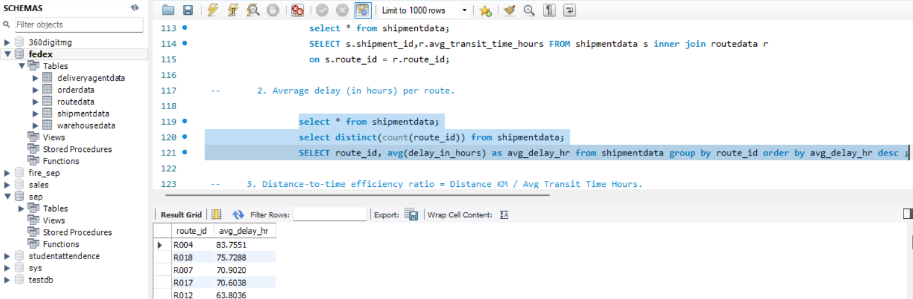
Task3:Route Optimization Insights (20 Marks) 2. Average delay (in hours) per route.
select * from shipmentdata;
select distinct(count(route_id)) from shipmentdata;
SELECT route_id, avg(delay_in_hours) as avg_delay_hr from shipmentdata group by route_id order by avg_delay_hr desc ;

Slide 15
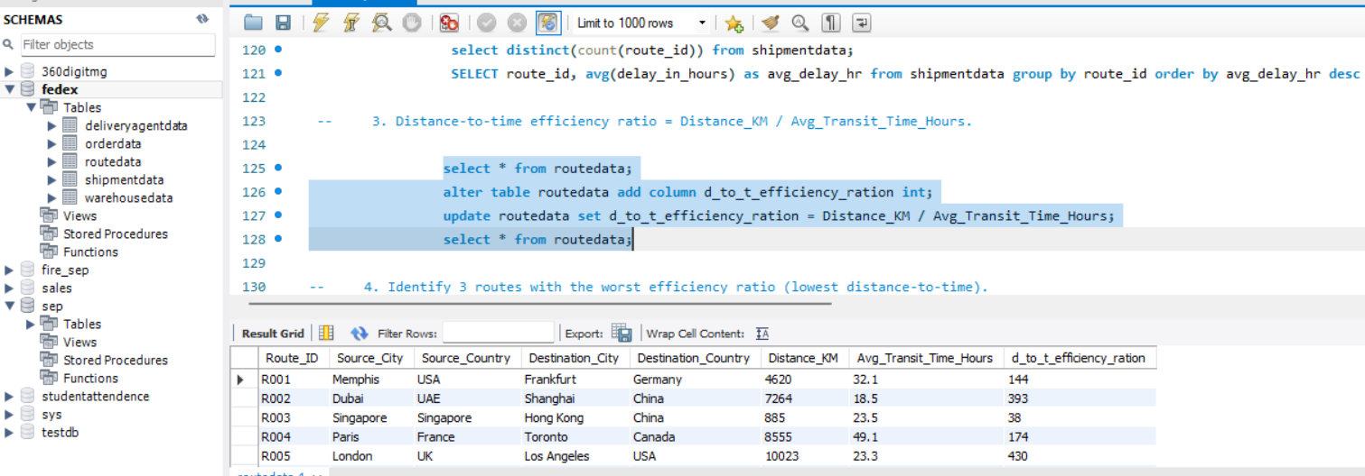
Task3:Route Optimization Insights (20 Marks) 3. Distance-to-time efficiency ratio = Distance_KM / Avg_Transit_Time_Hours.
select * from routedata;
alter table routedata add column d_to_t_efficiency_ration int;
update routedata set d_to_t_efficiency_ration = Distance_KM / Avg_Transit_Time_Hours;
select * from routedata;

Slide 16
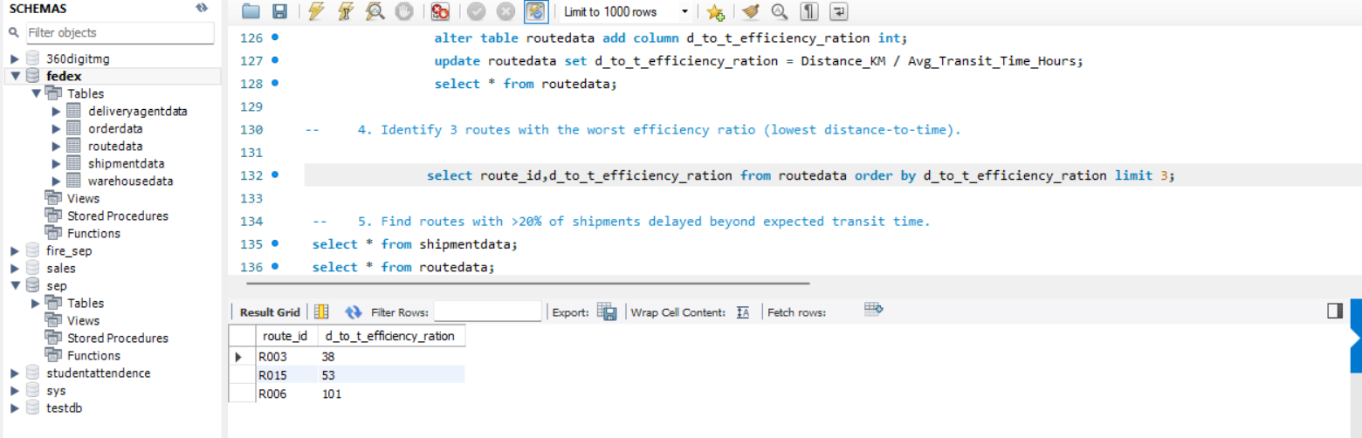
Task3:Route Optimization Insights (20 Marks) 4. Identify 3 routes with the worst efficiency ratio (lowest distance-to-time).
select route_id,d_to_t_efficiency_ration from routedata order by d_to_t_efficiency_ration limit 3;

Slide 17
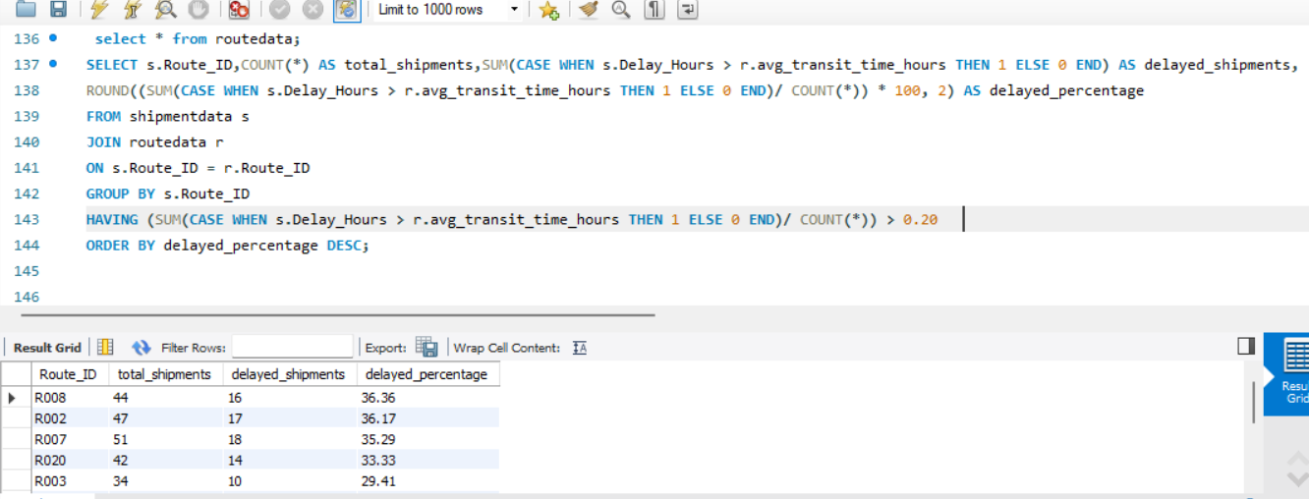
Task3:Route Optimization Insights (20 Marks) 5. Find routes with >20% of shipments delayed beyond expected transit time.
select * from routedata;
SELECT s.Route_ID,COUNT(*) AS total_shipments,SUM(CASE WHEN s.Delay_Hours > r.avg_transit_time_hours THEN 1 ELSE 0 END) AS delayed_shipments,ROUND((SUM(CASE WHEN s.Delay_Hours > r.avg_transit_time_hours THEN 1 ELSE 0 END)/ COUNT(*)) * 100, 2) AS delayed_percentageFROM shipmentdata sJOIN routedata r ON s.Route_ID = r.Route_IDGROUP BY s.Route_IDHAVING (SUM(CASE WHEN s.Delay_Hours > r.avg_transit_time_hours THEN 1 ELSE 0 END)/ COUNT(*)) > 0.20 ORDER BY delayed_percentage DESC;

Slide 18
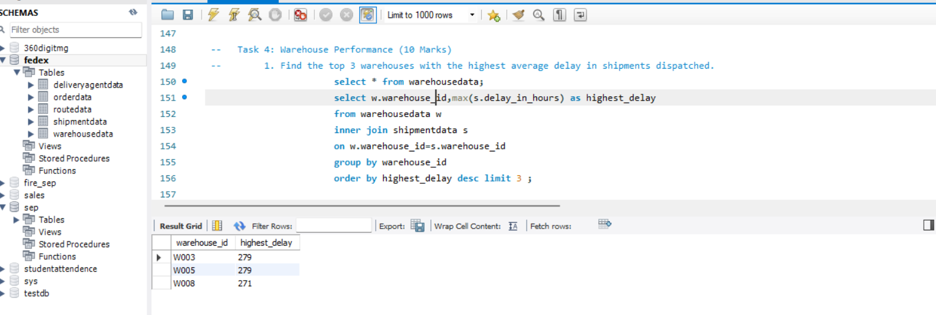
Task4: Warehouse Performance (10 Marks) 1. Find the top 3 warehouses with the highest average delay in shipments dispatched.
select * from warehousedata;
select w.warehouse_id,max(s.delay_in_hours) as highest_delay from warehousedata w inner join shipmentdata s
on w.warehouse_id=s.warehouse_id group by warehouse_id
order by highest_delay desc limit 3

Slide 19
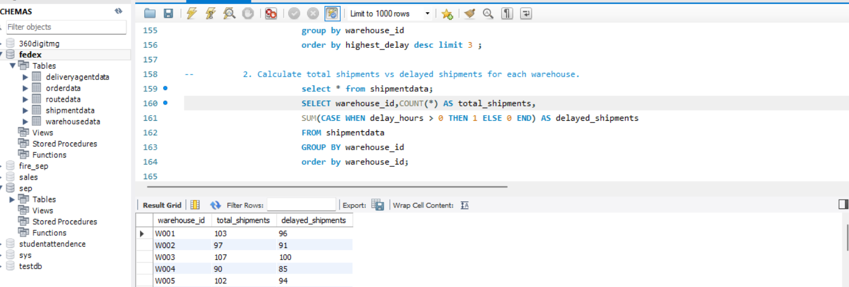
Task4: Warehouse Performance (10 Marks) 2. Calculate total shipments vs delayed shipments for each warehouse.
select * from shipmentdata;
SELECT warehouse_id,COUNT(*) AS total_shipments,
SUM(CASE WHEN delay_hours > 0 THEN 1 ELSE 0 END) AS delayed_shipments FROM shipmentdata GROUP BY warehouse_id
order by warehouse_id;

Slide 20
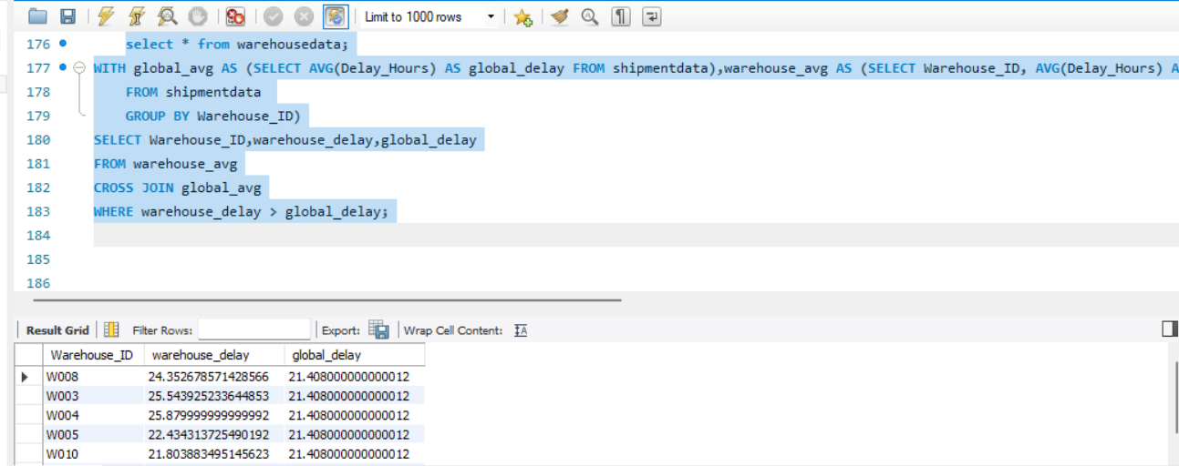
Task4: Warehouse Performance (10 Marks) 3. Use CTEs to identify warehouses where average delay exceeds the global average delay.
select * from warehousedata;
WITH global_avg AS (SELECT AVG(Delay_Hours) AS global_delay FROM shipmentdata),warehouse_avg AS (SELECT Warehouse_ID, AVG(Delay_Hours) AS warehouse_delay FROM shipmentdata GROUP BY Warehouse_ID)SELECT Warehouse_ID,warehouse_delay,global_delayFROM warehouse_avgCROSS JOIN global_avgWHERE warehouse_delay > global_delay;

Slide 21
Task4: Warehouse Performance (10 Marks) 4. Rank all warehouses based on on-time delivery percentage.
select * from warehousedata;
select warehouse_id,count(warehouse_id) from shipmentdata where delay_hours <= 0 group by warehouse_id order by warehouse_id;
SELECT w.warehouse_id,w.city, COUNT(*) AS total_shipments, SUM(CASE WHEN s.delay_hours <= 0 THEN 1 ELSE 0 END) AS ontime_shipments,ROUND((SUM(CASE WHEN s.delay_hours <= 0 THEN 1 ELSE 0 END) / COUNT(*)) * 100,2) AS ontime_percentage,RANK() OVER (ORDER BY (SUM(CASE WHEN s.delay_hours <= 0 THEN 1 ELSE 0 END) / COUNT(*)) DESC) AS warehouse_rank FROM shipmentdata s JOIN warehousedata w ON s.warehouse_id = w.warehouse_id GROUP BY w.warehouse_id, w.city ORDER BY warehouse_rank;

Slide 22
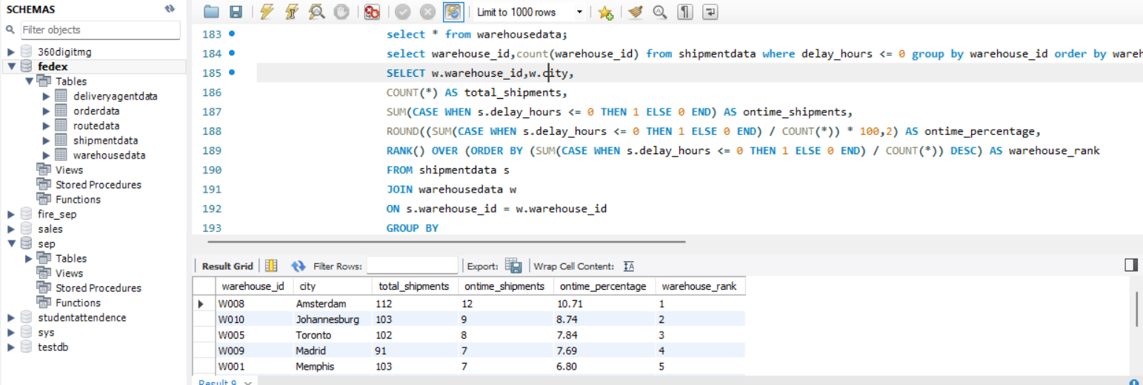
Task 4.4

Slide 23
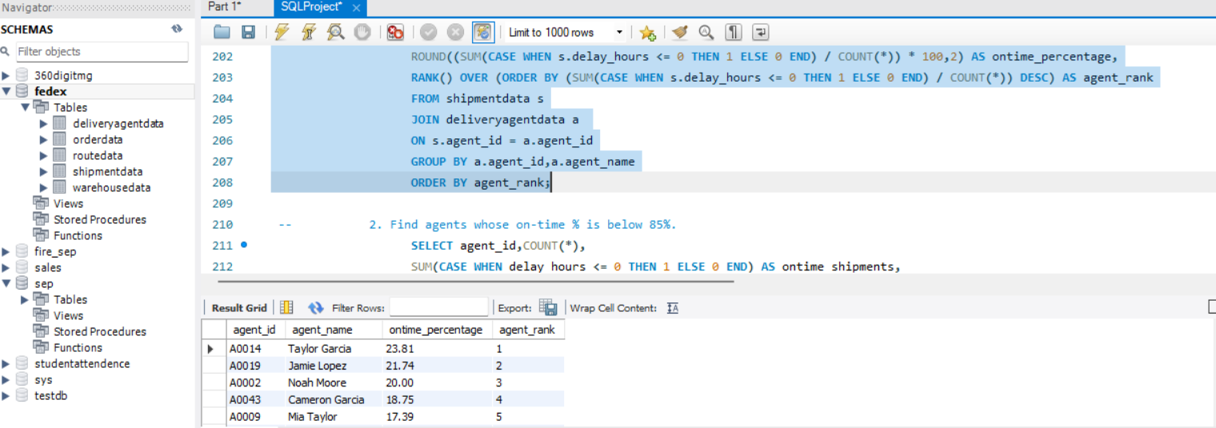
Task 5: Delivery Agent Performance (10 Marks) -- 1. Rank delivery agents (per route) by on-time delivery percentage.
select a.agent_id,a.agent_name, ROUND((SUM(CASE WHEN s.delay_hours <= 0 THEN 1 ELSE 0 END) / COUNT(*)) * 100,2) AS ontime_percentage,RANK() OVER (ORDER BY (SUM(CASE WHEN s.delay_hours <= 0 THEN 1 ELSE 0 END) / COUNT(*)) DESC) AS agent_rank FROM shipmentdata s JOIN deliveryagentdata a ON s.agent_id = a.agent_id GROUP BY a.agent_id,a.agent_name ORDER BY agent_rank;

Slide 24
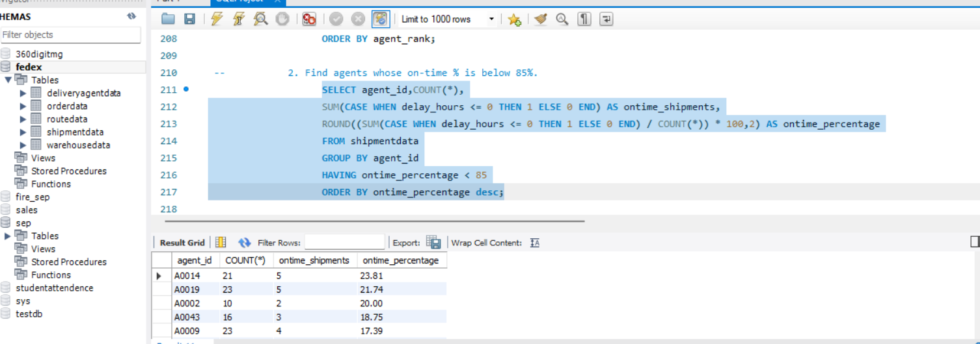
Task 5: Delivery Agent Performance (10 Marks) 2. Find agents whose on-time % is below 85%.
SELECT agent_id,COUNT(*),SUM(CASE WHEN delay_hours <= 0 THEN 1 ELSE 0 END) AS ontime_shipments,ROUND((SUM(CASE WHEN delay_hours <= 0 THEN 1 ELSE 0 END) / COUNT(*)) * 100,2) AS ontime_percentage FROM shipmentdata GROUP BY agent_id HAVING ontime_percentage < 85 ORDER BY ontime_percentage desc;

Slide 25
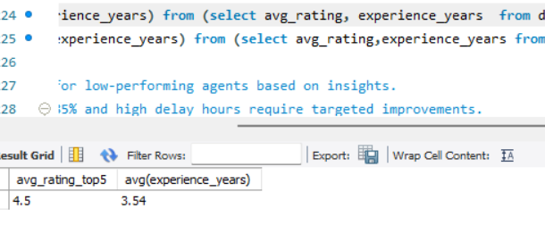
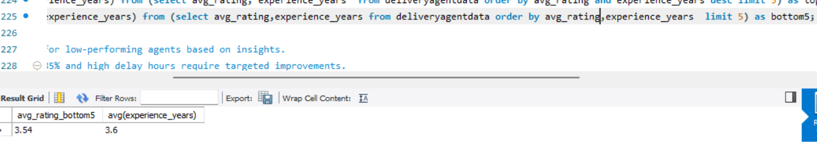
Task 5: Delivery Agent Performance (10 Marks) -- 3. Compare the average rating and experience (in years) of the top 5 vs bottom 5 agents using subqueries.
select avg(avg_rating) as avg_rating_top5,avg(experience_years) from (select avg_rating, experience_years from deliveryagentdata order by avg_rating and experience_years desc limit 5) as top5;
select avg(avg_rating ) as avg_rating_bottom5,avg(experience_years) from (select avg_rating,experience_years from deliveryagentdata order by avg_rating,experience_years limit 5) as bottom5;

Slide 26
Task 5: Delivery Agent Performance (10 Marks) -- 4. Suggest training or workload balancing strategies for low-performing agents based on insights.
Agents with on-time delivery percentage below 85% and high delay hours require targeted improvements. The following strategies are recommended:
Provide route optimization and time-management training.
Assign fewer and shorter routes temporarily.
Pair low performers with senior agents for mentorship.
Rebalance workload during peak hours to avoid delivery bottlenecks.
Introduce continuous monitoring and feedback sessions to track improvement.

Slide 27
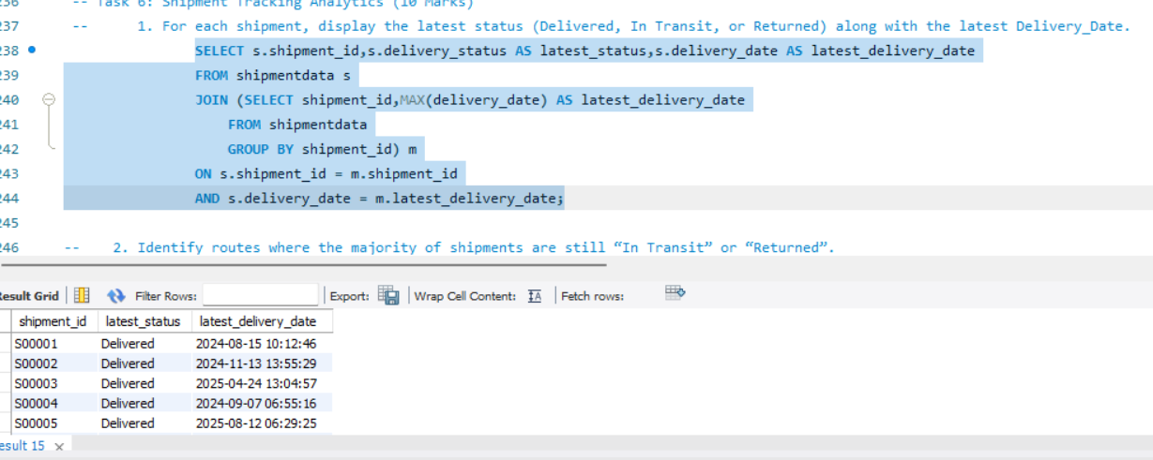
Task 6: Shipment Tracking Analytics (10 Marks) 1. For each shipment, display the latest status (Delivered, In Transit, or Returned) along with the latest Delivery_Date.
SELECT s.shipment_id,s.delivery_status AS latest_status,s.delivery_date AS latest_delivery_date FROM shipmentdata s JOIN (SELECT shipment_id,MAX(delivery_date) AS latest_delivery_date FROM shipmentdata GROUP BY shipment_id) m
ON s.shipment_id = m.shipment_id AND s.delivery_date = m.latest_delivery_date;

Slide 28
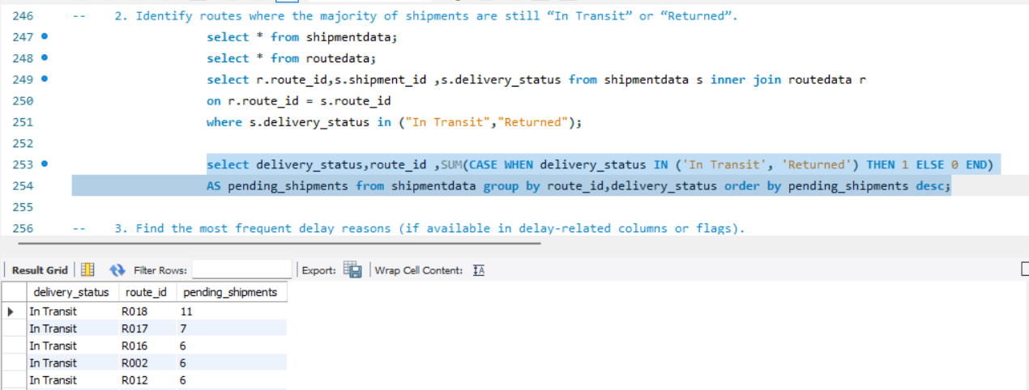
Task 6: Shipment Tracking Analytics (10 Marks) -- 1. For each shipment, display the latest status (Delivered, In Transit, or Returned) along with the latest Delivery_Date.
select delivery_status,route_id ,SUM(CASE WHEN delivery_status IN ('In Transit', 'Returned') THEN 1 ELSE 0 END) AS pending_shipments from shipmentdata group by route_id,delivery_status order by pending_shipments desc;

Slide 29
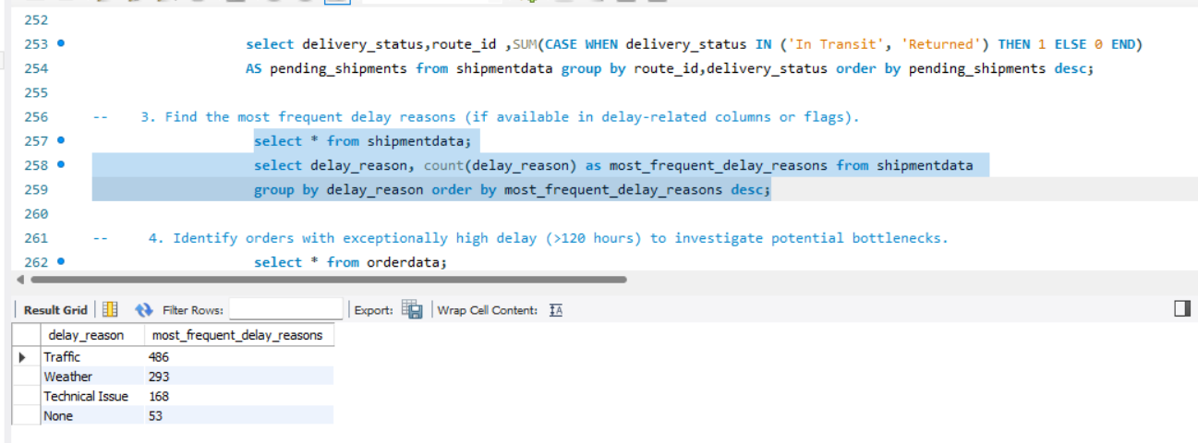
Task 6: Shipment Tracking Analytics (10 Marks) -- 3. Find the most frequent delay reasons (if available in delay-related columns or flags).
select * from shipmentdata;
select delay_reason, count(delay_reason) as most_frequent_delay_reasons from shipmentdata group by delay_reason order by most_frequent_delay_reasons desc;

Slide 30
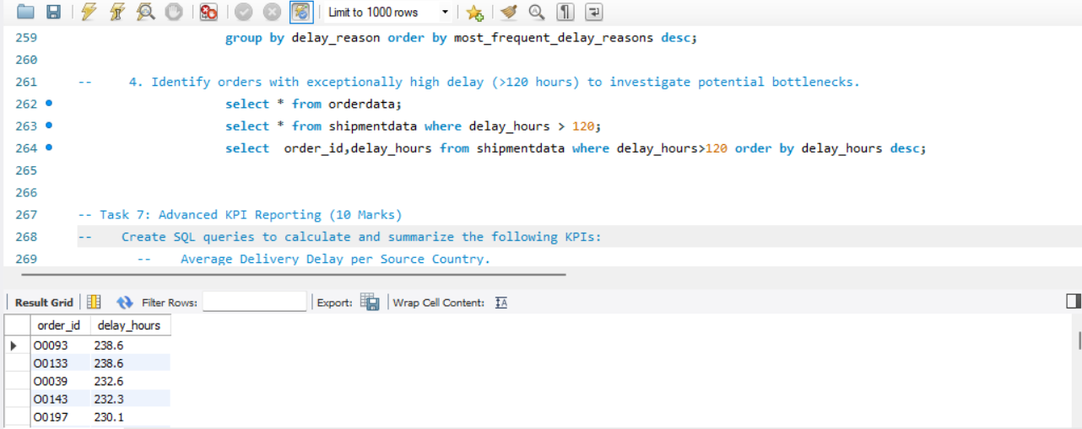
Task 6: Shipment Tracking Analytics (10 Marks) -- 4. Identify orders with exceptionally high delay (>120 hours) to investigate potential bottlenecks.
select * from orderdata;
select * from shipmentdata where delay_hours > 120;
select order_id,delay_hours from shipmentdata where delay_hours>120 order by delay_hours desc;

Slide 31
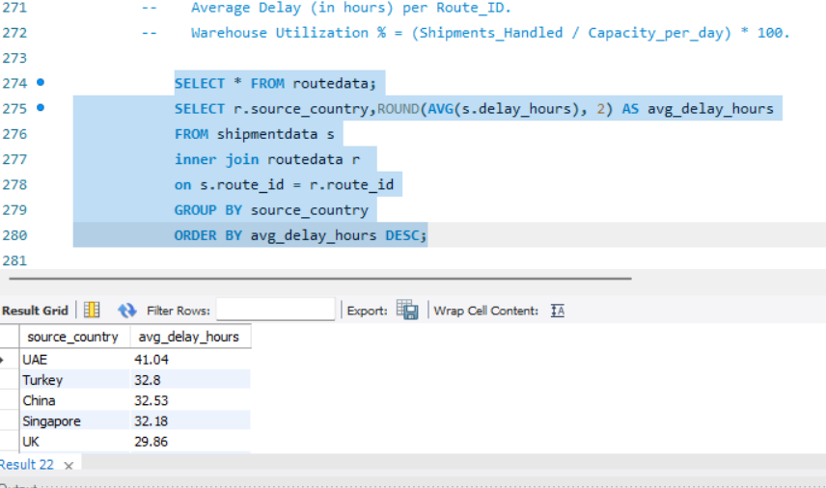
Task 7: Advanced KPI Reporting (10 Marks) Create SQL queries to calculate and summarize the following KPIs:
1. Average Delivery Delay per Source_Country.
SELECT * FROM routedata;
SELECT r.source_country,ROUND(AVG(s.delay_hours), 2) AS avg_delay_hours FROM shipmentdata s inner join routedata r on s.route_id = r.route_id GROUP BY source_country ORDER BY avg_delay_hours DESC;

Slide 32
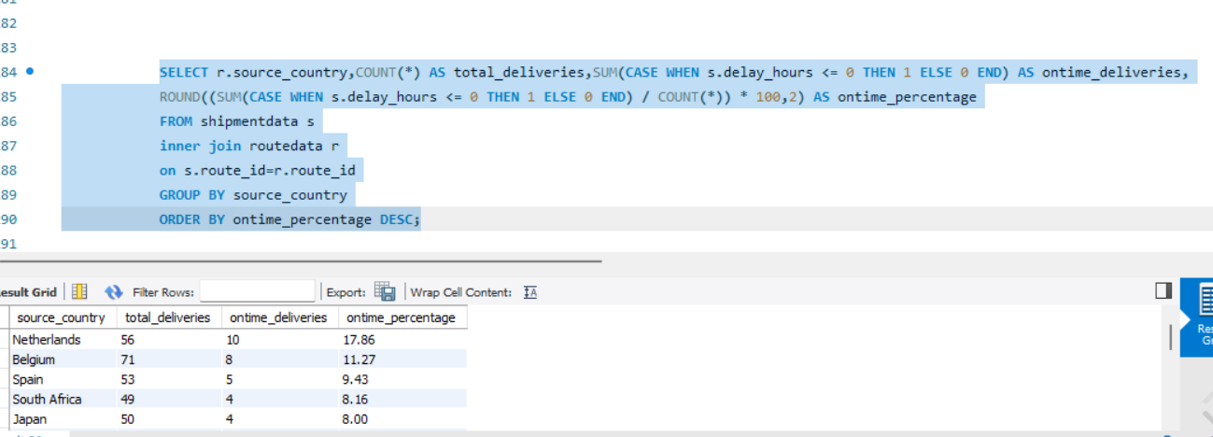
Task 7: Advanced KPI Reporting (10 Marks) -- Create SQL queries to calculate and summarize the following KPIs:
2. On-Time Delivery % = (Total On-Time Deliveries / Total Deliveries) * 100.
SELECT r.source_country,COUNT(*) AS total_deliveries,SUM(CASE WHEN s.delay_hours <= 0 THEN 1 ELSE 0 END) AS ontime_deliveries,ROUND((SUM(CASE WHEN s.delay_hours <= 0 THEN 1 ELSE 0 END) / COUNT(*)) * 100,2) AS ontime_percentage FROM shipmentdata s inner join routedata r on s.route_id=r.route_id GROUP BY source_country ORDER BY ontime_percentage DESC;

Slide 33
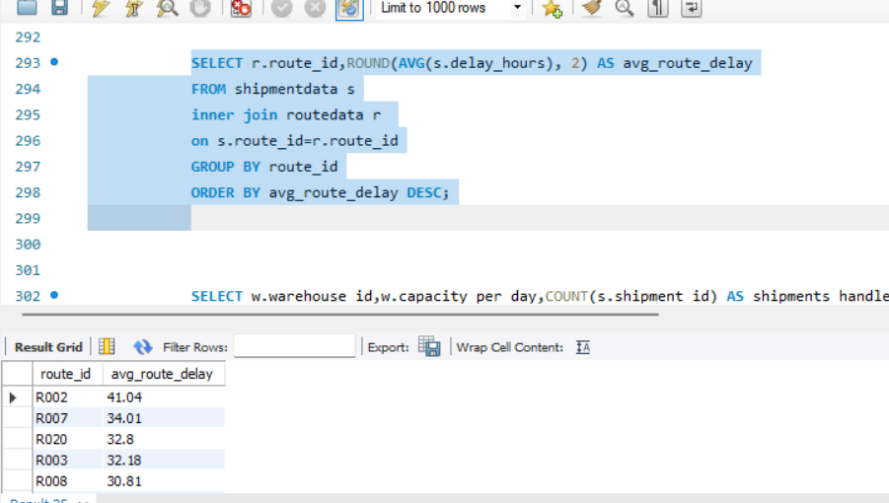
Task 7: Advanced KPI Reporting (10 Marks) -- Create SQL queries to calculate and summarize the following KPIs:
3. Average Delay (in hours) per Route_ID.
SELECT r.route_id,ROUND(AVG(s.delay_hours), 2) AS avg_route_delay FROM shipmentdata s inner join routedata r on s.route_id=r.route_id GROUP BY route_id ORDER BY avg_route_delay DESC;

Slide 34
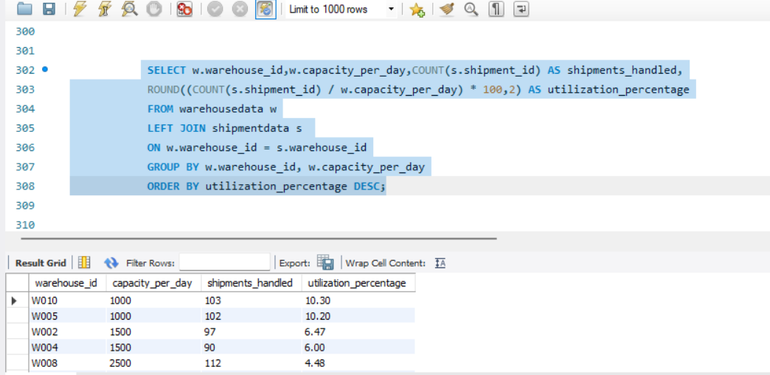
Task 7: Advanced KPI Reporting (10 Marks) -- Create SQL queries to calculate and summarize the following KPIs:
4. Warehouse Utilization % = (Shipments_Handled / Capacity_per_day) * 100.
SELECT w.warehouse_id,w.capacity_per_day,COUNT(s.shipment_id) AS shipments_handled, ROUND((COUNT(s.shipment_id) / w.capacity_per_day) * 100,2) AS utilization_percentage FROM warehousedata w LEFT JOIN shipmentdata s ON w.warehouse_id = s.warehouse_id GROUP BY w.warehouse_id, w.capacity_per_day ORDER BY utilization_percentage DESC;

Slide 35
Key Insights
Route Delays Identified: Multiple routes (e.g., R008, R002,R007,R0020) show >20% delayed shipments, indicating congestion or operational inefficiencies.
High Average Delay in Specific Warehouses: Some warehouses exceed the global average delay, suggesting processing or capacity issues.
Inconsistent Agent Performance: Several agents have <85% on-time performance, affecting overall delivery reliability.
Status Distribution Gaps: A notable share of shipments remain in “In Transit” or “Returned” status on high-volume routes.
Underutilized Hubs: Certain warehouses operate below capacity while others are overloaded, reducing network efficiency.

Slide 36
Business Recommendations
1. Route Optimization
Introduce intermediate hubs (e.g., Nagpur, Hubli) for long routes to reduce transit variability.
Apply traffic-aware routing and predictive delay modeling.
2. Warehouse Efficiency Improvement
Balance load by rerouting some shipments from overloaded warehouses (e.g., WH3) to underutilized hubs.
Improve sorting and loading processes during peak hours.
3. Improve Agent Performance
Provide targeted training on navigation, scanning accuracy, and timing.
Shift underperforming agents to shorter, simpler routes.
Incentivize high-performing agents.
4. Reduce “In Transit” and “Returned” Issues
Strengthen address verification and customer communication.
Use real-time tracking to monitor bottlenecks.
5. Capacity Planning & Forecasting
Use data trends to optimize vehicle allocation, peak-hour staffing, and warehouse capacity expansion

